Slide 1


Sports & well-being
Manas K Mandal, PhD, FNAPsy
Distinguished Visiting. Professor, IIT-Kharagpur
A career & a paired career

Slide 2
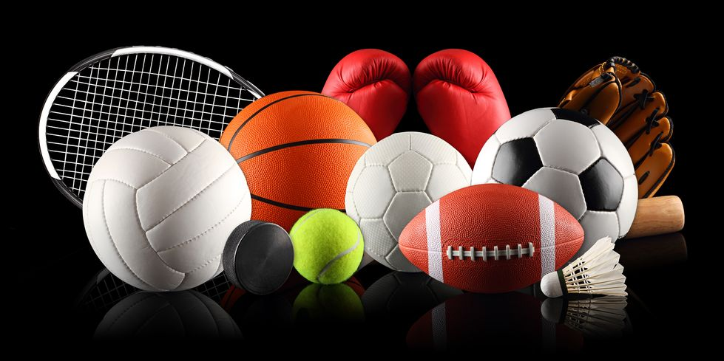
Career Decision Making…
How do I prioritize career decision?
Interest – Ability - Expectation
What motivates me to take a career decision?
Power – Affiliation - Achievement
How do I take a career decision?
Reason – Intuition - Feeling
What guides me to take a career decision?
Value – Norm - Reality

Slide 3
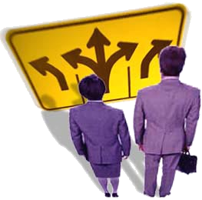
Decidophobia…in career choice
Choice vs. Compulsion
Stability vs. Dynamicity
Pride vs. Brand
Economic vs. Social reward
Life vs. Career

Slide 4

Sports vs Academics
How does Rohan feel?
"My parents are great, but why do they always tell me what to do? It stresses me out."
"Why does mom keep a tab on every minute of mine? She is over-scheduling me though I know that she wants me to focus on studies too."
"It is like I'm never quite good enough; I can't fully please my parents, either in sports or studies.“
Rohan's mom has her own set of thoughts:
"By the time he is home, he will again be too tired to finish his homework."
"What if he doesn't turn out to be a good sports person and lags behind in studies too?"
"I hope he understands one day, that I am doing this for his own good!"
https://www.indiatoday.in/education-today/featurephilia/story/balancing-sports-and-academics-330125-2016-07-19

Slide 5
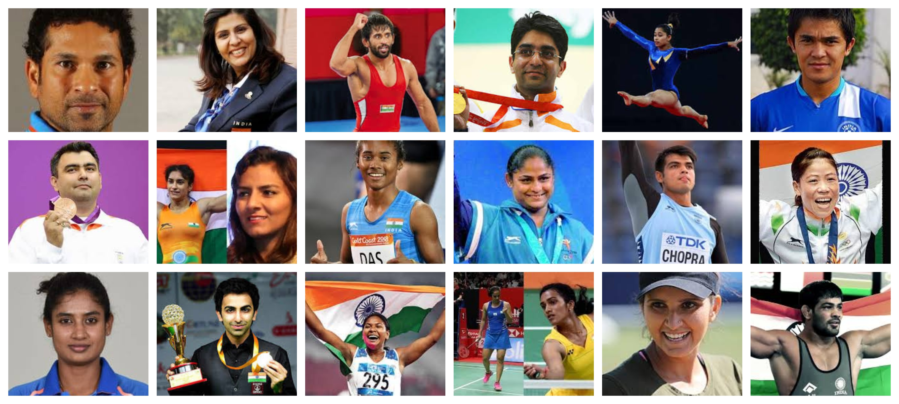
Misconceptions
The core of ‘sports & well being’ is ‘success’ only
Mental training focuses on negatives
Mental conditioning is only for athletes who are weak
Nice guys rarely wins the race
Winners shall practice-till-they-drop

Slide 6
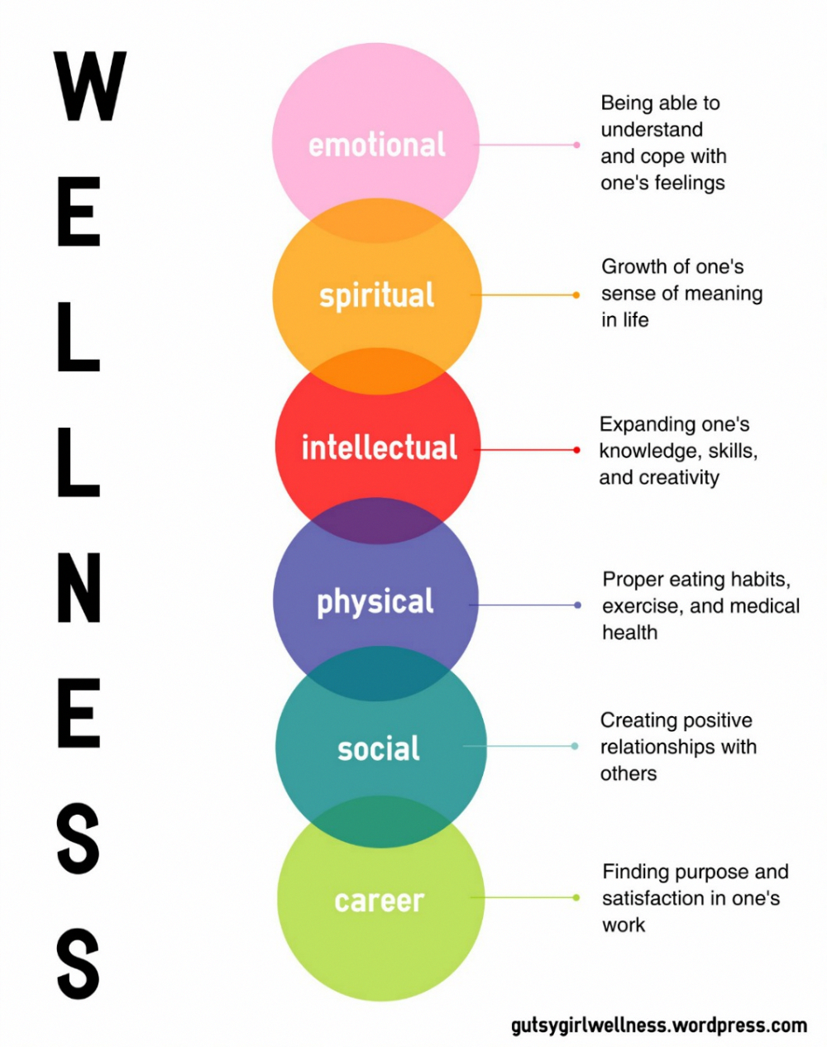
Why well-being is important...?
to develop a psychological ‘edge’ in competitive sports
to manage failure, & to avoid second thoughts
to develop social skills & bonding with teammates
to manage stress, anxiety /isolation, & peer relationship within & outside the games
to build a paired career to avoid post-career difficulties

Slide 7
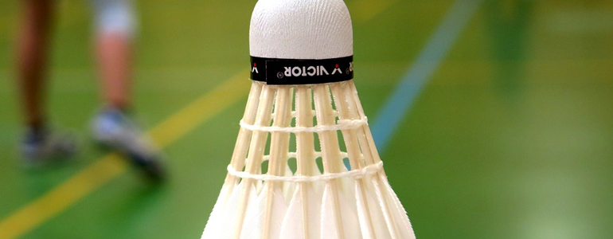
Major Questions...
Can physical feat or technical skill alone win medal in highly competitive sport?
What crucial mental aspect separates a medal winner from the rest?
How ordinary athletes upset their more touted opponents in high-stake competitions?
Why ‘athlete readiness’ is also important outside the narrow focus of medal winning?

Slide 8
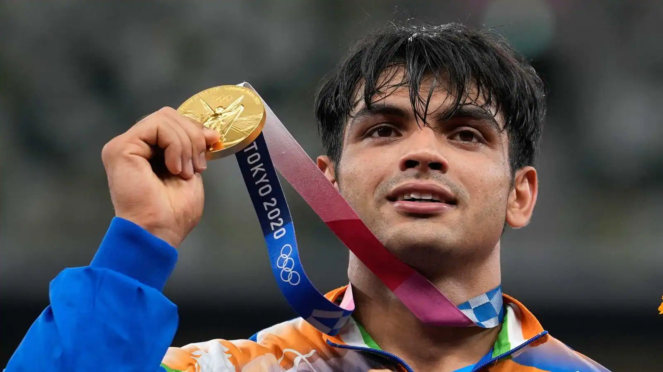
Our focus... in well-being
…not about Medals only, it’s about the journey behind
…not about Winners only, more about those who face hurdles
… not about failure only, it’s about those who learn to bounce back
…not about developing ‘self’, it’s about growing with others, developing ‘between’-ness in team

Slide 9
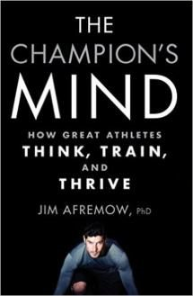
Disciplines that contribute to sports science
Exercise physiology
Sports bio-mechanics
Physiotherapy
Sports medicine & nutrition
Strength & conditioning science
Kin-anthropometry
Computational performance analysis
Sports tool technology
Sports psychology

Slide 10
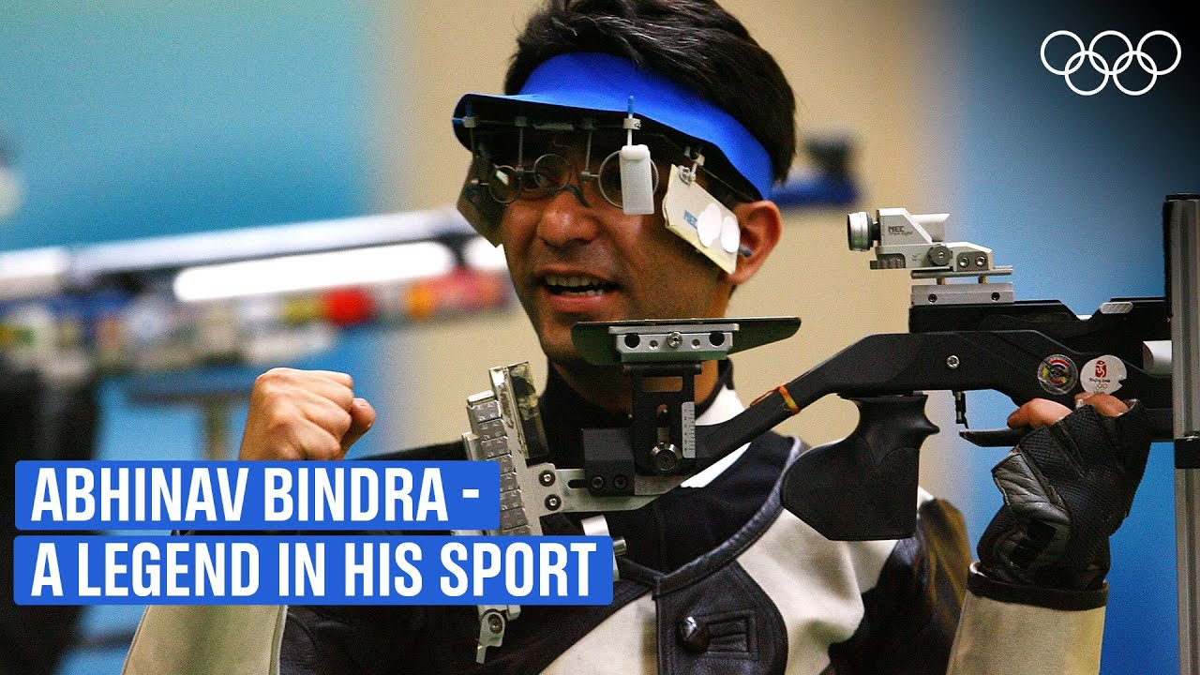
Sports Academy: mental conditioning
Psychological skills training for athletes
Goal-setting & performance profiling
Self-regulation techniques in competition
Concentration & attention control strategies
Poise & emotion management training
Attribution interpretations & self-assessment in sport
Chaining behavior sequences to develop skill

Slide 11
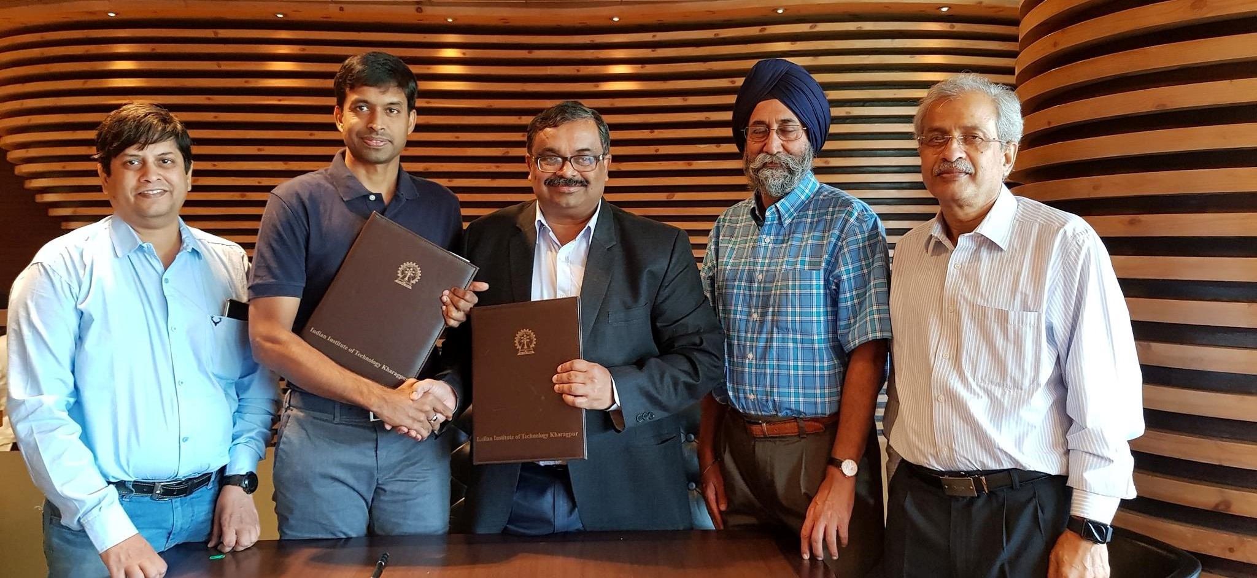
Sports Academy: mental conditioning
Injury & rehabilitation
Overtraining & burnout counseling
Team cohesion training, team building
Grief, depression, & loss counseling for athletes
Moral & character development in sports, sportsmanship
Early identification & prevention of psychological difficulties
Existential threat of disillusionment after a peak performance

Slide 12
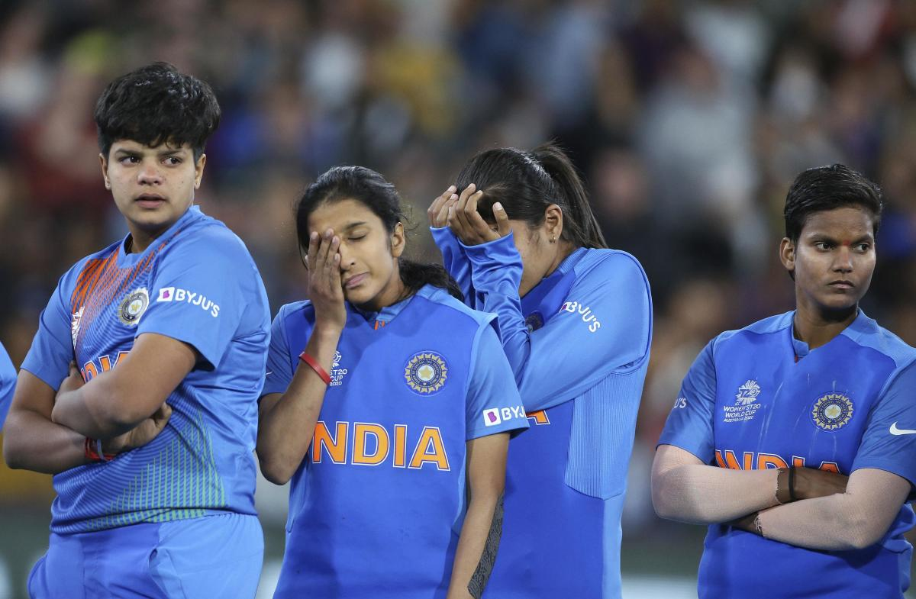
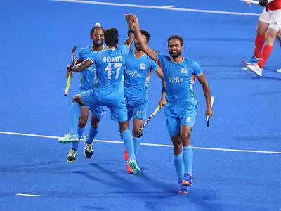
Sports & well-being domains...
Happiness & Unhappiness: Imparts knowledge about what makes us happy. Misconceptions in our belief system that causes unhappiness & produce bodily changes
Optimism: Aims at discovering & promoting conditions that enable individuals to thrive. Also deals with the issue of optimism bias that causes a person to overestimate the chances of success

Slide 13
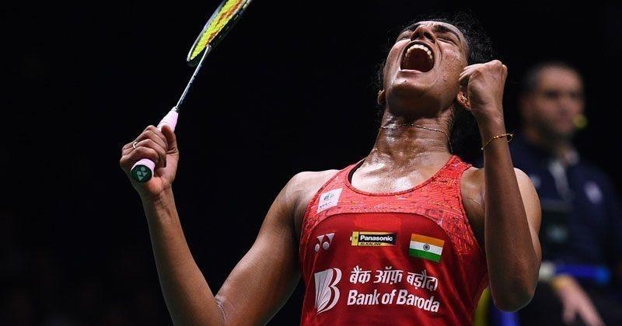
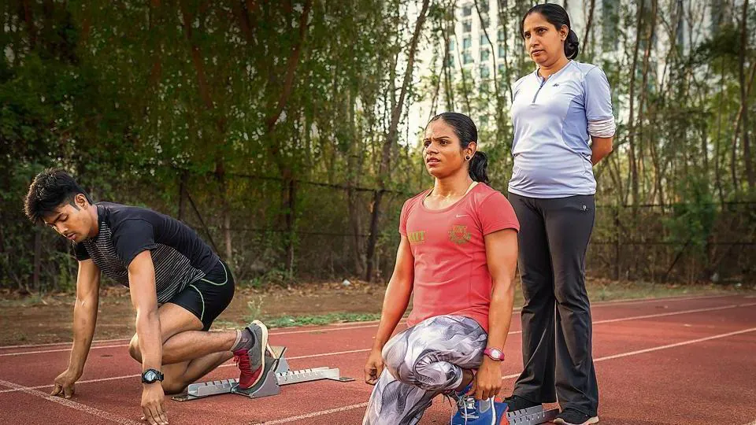
Sports & well-being
Emotional intelligence: Helps in conducting an ‘inner dialogue’ for managing feeling & impulses, reading & interpreting social cues, understanding perspectives of others, & knowing the difference between feeling & actions
Arousal control: Discusses ways & means to avoid the perception of stress which is subjective in nature. It occurs when there is a perceived imbalance between pressure & coping resources for a situation

Slide 14

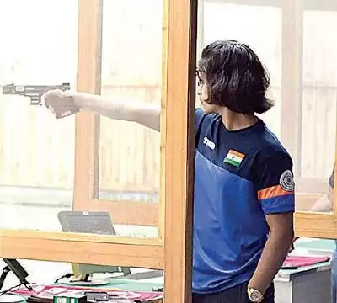
Sports & well-being
Motivation: Direction and intensity of one’s effort toward developing excellence in sport. Deals with Goal setting, goal orientation, reward / punishment & intrinsic motivation
Attention & concentration: The process implies withdrawal from other irrelevant input to deal effectively with a situation. Deals with deliberate investment of conscious effort, ability to ‘zoom-in’, & divided attention for concurrent actions.

Slide 15
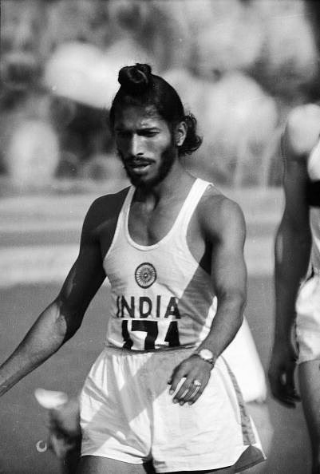
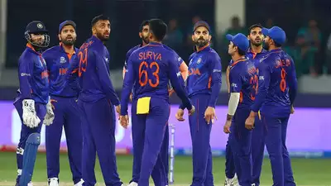
Sports & well-being
Resilience: Discusses ways & means to bounce back from the frustrations of failure. It’s a process of adapting well in face of adversity, or of unusual difficulty.
Decision making: Deals with the psychological process through which we take decisions in uncertain conditions. It will also cover the sources of our bias & prejudices in judgment about others

Slide 16
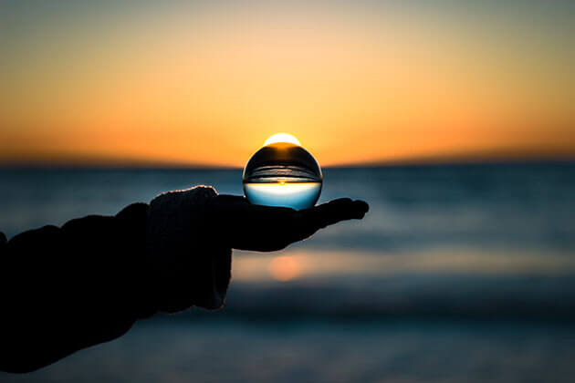
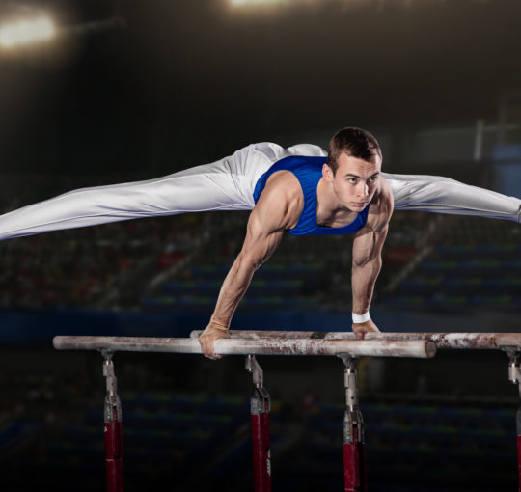
Techniques to improve performance...
Mindfulness: ‘Mindfulness’ exercise assist participants to be aware & awake in the present moment. It is a practice of touching daily life deeply every moment of our existence.
Attentional training: to reallocate & adjust attention to focus in on the specific actions relevant to that specific moment in time, to better control a wandering mind, and to focus during complex situations.

Slide 17
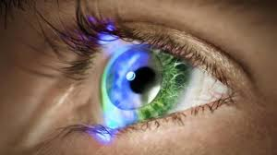
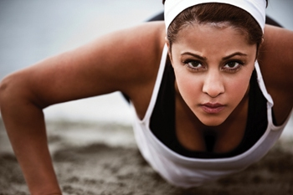
Techniques to improve performance...
Visualization: It is the process of creating a mental image or intention of what you want to happen or feel in reality.
Guided imagery: Through a combination of imagery sub-processes, such as image transformation, scanning, & sustenance, vivid & controllable images are generated

Slide 18
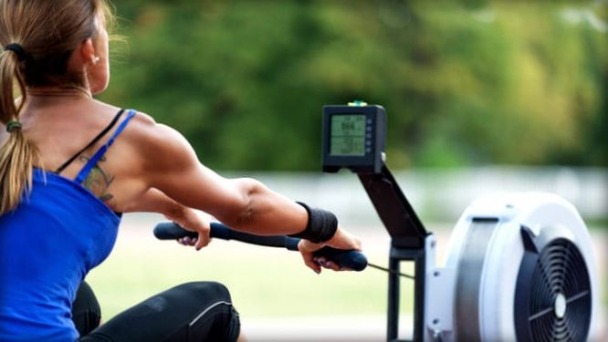
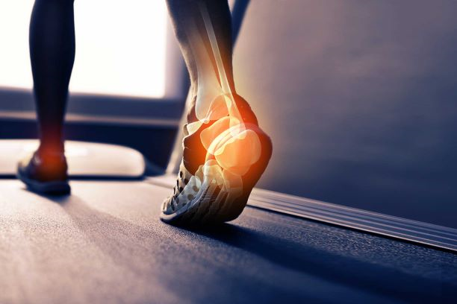
Techniques to improve performance...
Feedback & reinforcement: Applied behavior analysis is done to utilize feedback & reinforce behavior, involving positive reinforcement for proper movement, consistent feedback & chaining behavior sequence for complex skill.
Injury prevention & rehabilitation: With sports injury, players tend to experience drop in self-worth, begin attributing negatively, & start developing faulty coping strategy. Injury counseling addresses such issues.

Slide 19
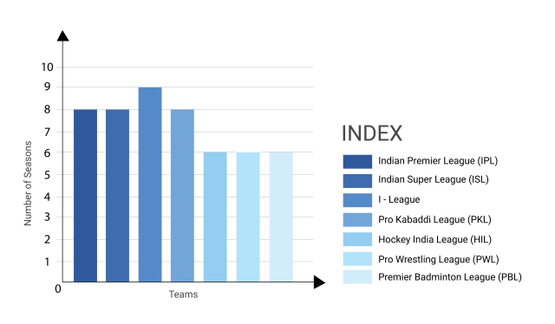
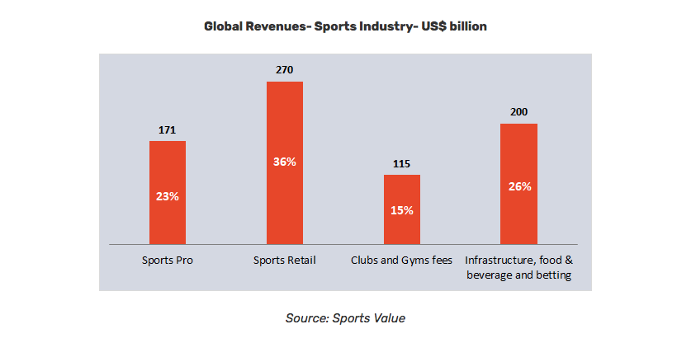
Developing a paired career in sports
Make a list of your skills & find the right fit
Shed self-doubt & figure out your transferable skills
Acquire new skills & learn from your mistakes
Keep your expectations in check
Make it a habit & set up a strong network
Set a deadline & have a financial plan
Convert without penalty & shed apprehension of hypothetical missed opportunity
Changing landscape of Indian sports

Slide 20
If you have a strong interest in sports but aren't a professional athlete…career options
Category 1 – Sports plus MBA = Sports Management
Team Management – take care of your entire team from budgets to marketing
Social Media Manager, Event planner
Sports marketing – Sponsorships, Intellectual property, merchandising,
Grassroot development – identifying and developing young players – MRF Pace Academy, Olympic Gold quest
Category 2 – Sports + Biology + Psychology = Sports Medicine and Sports Science
Sports medicine / Sports Physician– masters (UQ)
Sports physiotherapy / therapist –player rehabilitation & recovery programs
Sports and exercise science –to design the best exercises for each sport
Sports and nutrition
Sports psychology – motivation, stress, rehabilitation, performance
Kinesiology / Sports Biomechanics– ‘physics of sport’

Slide 21
Careers in sports
Category 3 – Sports Coaching and Education
Sports coaching and physical education – teaching and coaching practical skills as well as academic and scientific skills – career as a coach
Umpire/ Referee
Professor – of Sports Management
Category 4 – Sports + Computer Science / Engineering / Math / Statistics
Sports analytics – masters in Data science, or sports analytics or data analytics
Sports technology – industrial and product design for sports equipment. The courses are broad based and cover Sports Science, Design, Technology, and Engineering Science.
Category 5 – Sports Law
Sports Law - media law, contract law, competition law, anti-doping law

Slide 22
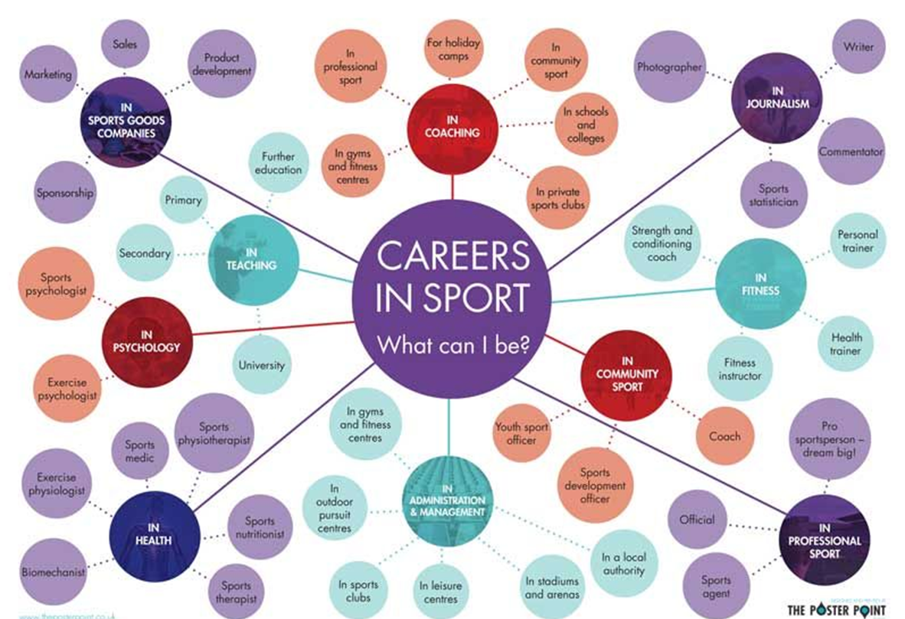
Careers in sports
Category 6 – Sports Journalism / Public Relations –
Public Relations
Broadcasting
Photo-journalism
Sport show producer
Editor, News reporter, Publisher
Radio caster
Market Research
e-sports
https://www.forbes.com/sites/jasonbelzer/2014/02/05/sports-industry-101-breaking-into-the-business-of-sports/?sh=60fe6c173db9

Slide 23
Sports psychologist
Assess the level of psychological strength in elite performers to set a standard
Enrich mental prowess for optimal performance by brain-train methods
How to develop resilience, social skills & bonding with competitors?
How to get rid of anxiety / isolation in a team?
How to retain psychological ‘edge’ in face of intense competition?

Slide 24
Colleges in India offer study in Sports
University of Technology and Management – Meghalaya
National Academy of Sports Management – Maharashtra
Centurion Univ of Technology & Management – Orissa
Dhyan Chand Sports College
Indian Institute of Social Welfare & Business Management
Gujarat University
Symbiosis School of Sport Sciences
George College, Kolkata, West Bengal
Institute of Sports Management, ISST, Pune
Tamil Nadu Physical Education & Sports University, Chennai
Netaji Subhash National Institute of Sports, Patiala
Indira Gandhi Institute of Physical Education and Sports Sciences, New Delhi
Lakshmibai National Institute of Physical Education, Gwalior and Thiruvananthapuram
National Academy of Sports Management, Ahmedabad, Delhi, Jaipur, Mumbai
International Institute of Sports Management, Mumbai
Tata Football Academy, Jamshedpur
National Cricket Academy, Bangalore
Algappa University, Tamil Nadu
Institute of Social Welfare and Business Management – West Bengal

Slide 25
